Slide 1
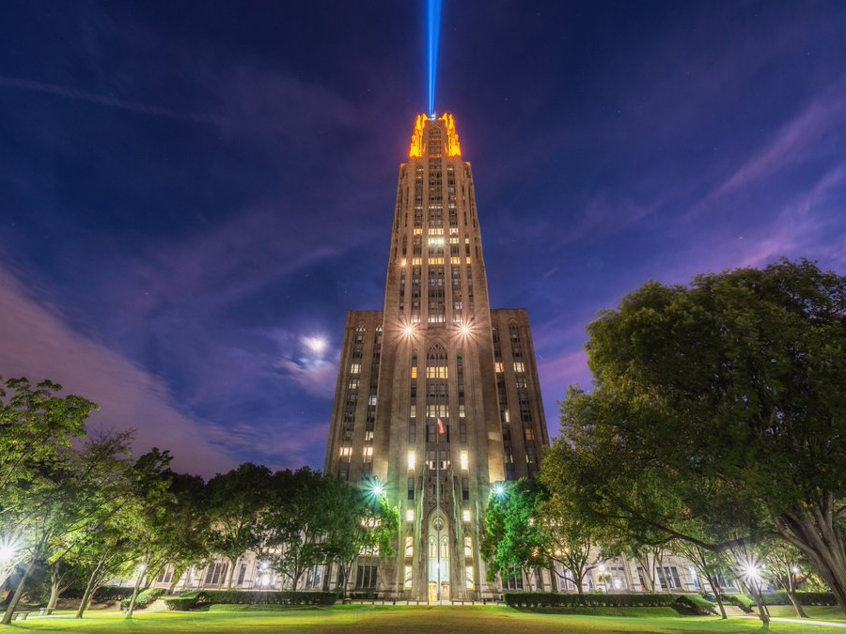
Gator Training
Department of Environmental Health and Safety
(412) 624-9505
www.ehs.pitt.edu

Slide 2
Introduction It is the responsibility of the Department to ensure training is implemented to all employees/department affiliates that are operating a utility vehicle. This document provides basic guidelines and safe operating practices for Utility vehicles owned and operated by the University of Pittsburgh. These guidelines are examples of some of the requirements and are not all inclusive.
This training establishes proper safety procedures and practices when utilizing Gators, Golf Carts, or Mini Trucks on campus.
All utility vehicles must have a strobe light placed on the utility vehicle as applicable.
All plated utility vehicles must be registered with the Office of Fleet Services.

Slide 3
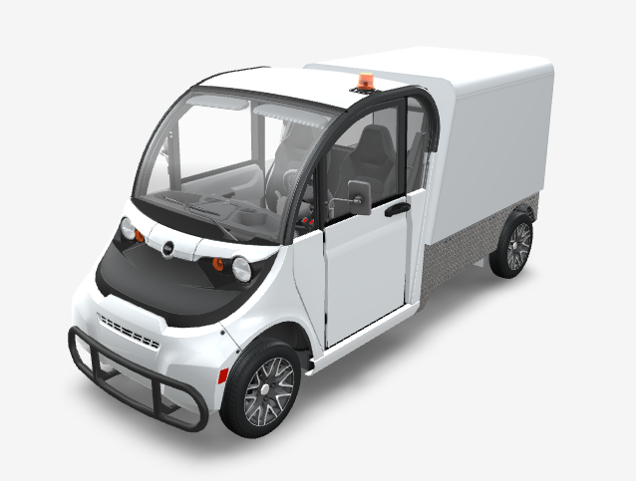
Gators, Golf Carts, or Mini Truck Types
PICTURED: GEM Low Speed Vehicle

Slide 4
Gators, Golf Carts, or Mini Truck Types Characteristics
Compact, powerful, and versatile machines
Commonly gasoline, diesel, or electric powered
Could be 2-wheel, 4-wheel, all-wheel drive, or tracked
Operates like a car/truck with a steering wheel, accelerator foot pedal, and a break foot pedal
High/low range & reverse transmission
Side by side or bench seating with seat belts
All-terrain tires with 20 PSI or less tire pressure
Hauling capability with cargo box
Towing capability with hitch
Easy to operate with training

Slide 5
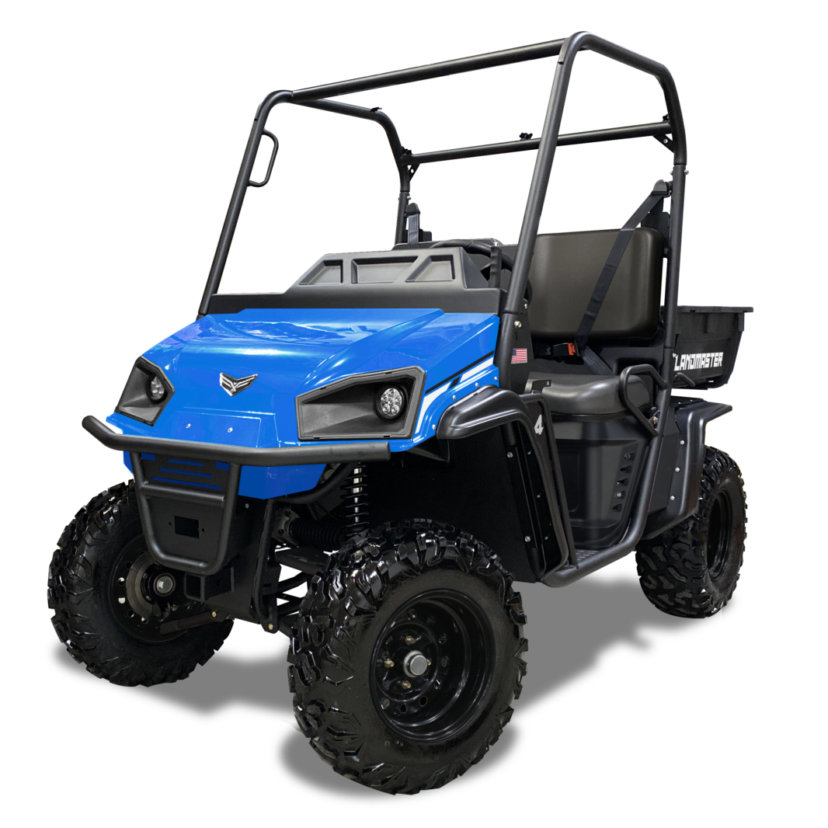
Permissible Use of UTV
Utility Type Vehicles may be operated as follows:
To transport people, equipment, or supplies
When operated by an eligible UTV operator
When UTV is properly serviced and equipped with all necessary equipment
On walkways or side walks in such a manner that they do not impede or interfere with normal pedestrian traffic, to a maximum speed of 5 mph
With the utmost courtesy, care, and consideration for the safety of pedestrians who will be always given the right of way

Slide 6
Permissible Use of UTV
Restrictions while operating UTV
Equipment should not be modified in any way that will affect the recommended mode of operation, speed, and/or safety
Never wear headphones, use cell phones, or any other device that may restrict hearing or control while operating.
Don’t talk/text and drive! Even if the call concerns important work-related business – pull over first!
Never operate any equipment under the influence of drugs or alcohol. This can include any prescription medication that makes you drowsy, dizzy, or impaired.
Smoking is prohibited inside UTVs.
Talk to your supervisor if you don’t feel you can operate an UTV.

Slide 7
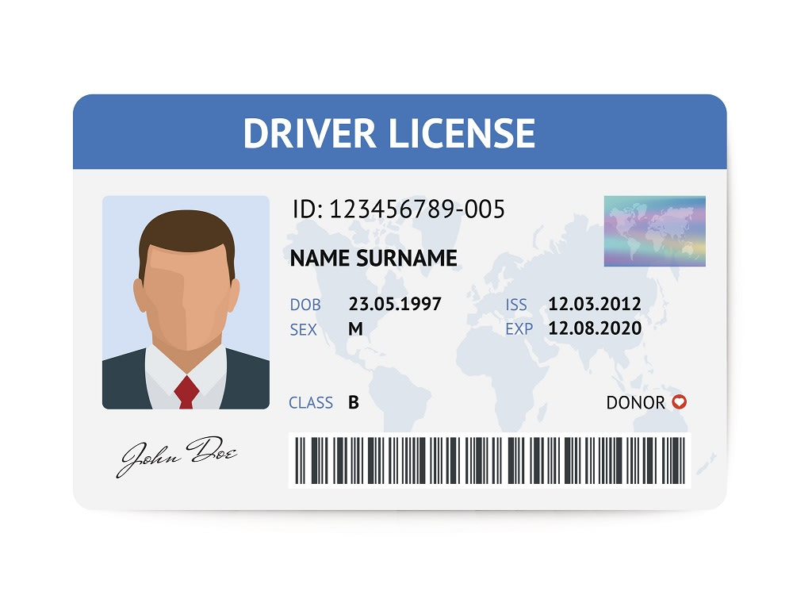
Permissible Use of UTV
Eligibility to Operate
University employees and approved affiliates are the only permitted drivers.
Employee must have a valid driver’s license. Driver’s license must be processed through the Office of Fleet Services. For more information, Department designee should email fleetservices@bas.pitt.edu
Obey all traffic regulations
Complete training annually
Ability to operate vehicles in a safe and responsible manner.

Slide 8
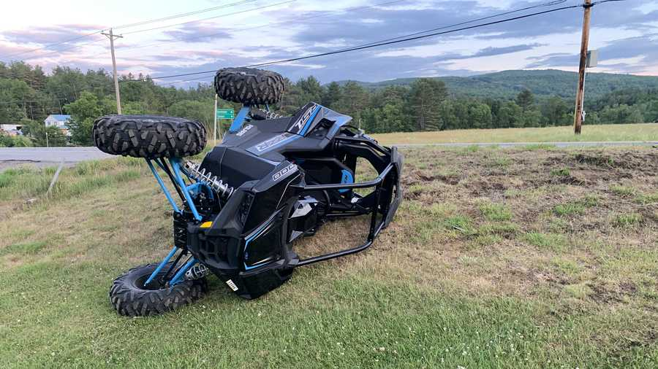
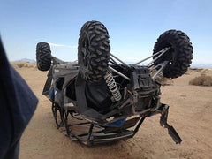
Potential Hazards
Rolling over on steep slopes, dangerous terrain, or fast turns
Collision with another vehicle or object
Pinch points, cut points, wrap points, and burns while working with the UTV
Fluids under high pressure or other stored energy
Injury to driver and passengers from shifting loads in cargo area
Injury from falling from the UTV when mounting and dismounting
Injury to the eyes from dust and insects while UTV is in motion
Injury to pedestrians from being struck by the UTV or from loads falling off UTV

Slide 9
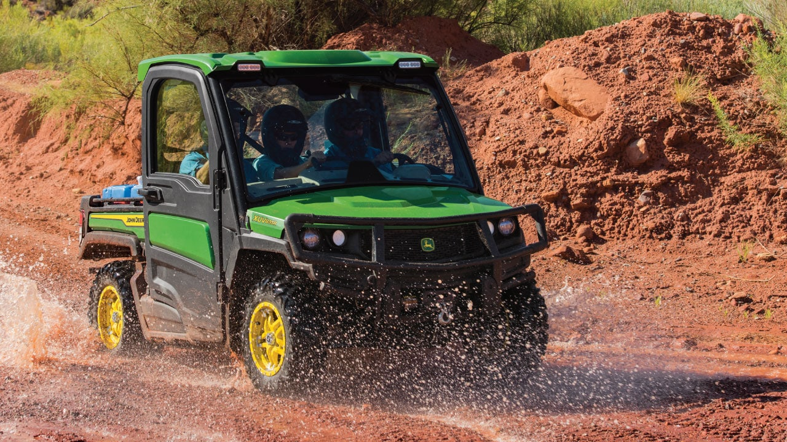
Prior to Use
Understand differences between UTV and a highway vehicle
UTV has:
Smaller wheelbase
Higher center of gravity
Center of gravity is always shifting during operation
Low pressure, off highway tires
Load Capacity
Know the manufacturer’s load weight limit and do not exceed
Overloading decreases your ability to maneuver and operate safely
When hauling cargo, the center of gravity is raised and moves towards the rear axle, increasing the risk of tip-over in any direction
Secure all equipment and supplies to prevent objects from falling out or striking people
Only one passenger per seat
No riding on back, front, or sides
Loads are only to be loaded, repositioned, or unloaded when the UTV is in park or neutral

Slide 10
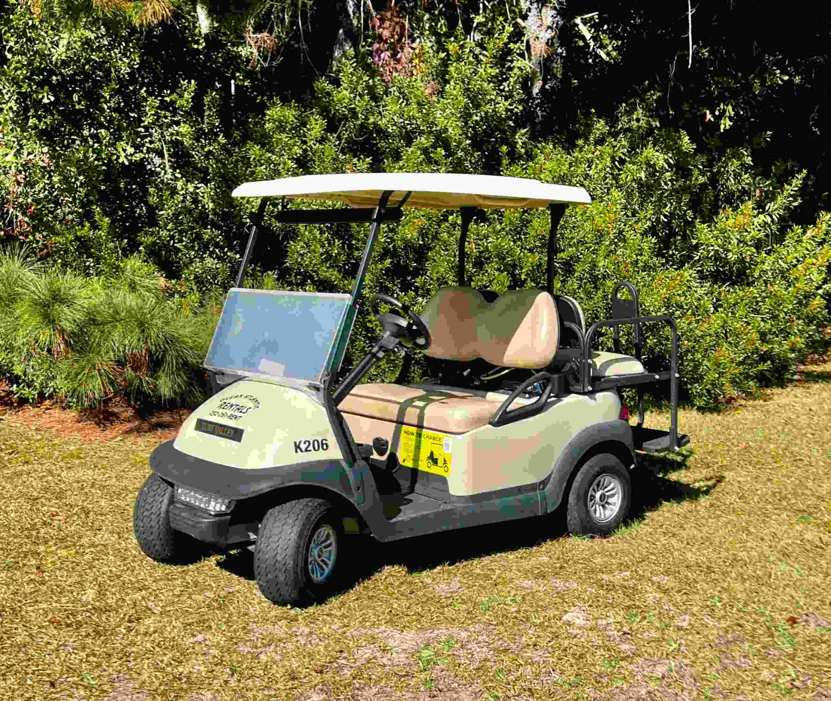
Prior to Use
Check for proper operation of critical equipment
Lighting
Head lights
Taillights
Brake lights
Turn signals
Brakes/Parking Brake
Work smoothly without noise or pulling
Reflector & Sign
Steering
Horn Tire Inflation and condition
Fuel level or Battery power
Batteries
Never use batteries to power other devices
Never use extension cords
Never attempt to check or add fluid to the battery
Chargers should be plugged directly into a ground fault circuit interrupter receptacle
Recharging outlets must be designed to be locked when not in use
Check for puddles, leaks, odors, strange sounds, or behavior that can indicate a large mechanical problem

Slide 11
Prior to Use
Towing capacity
Do not tow a load that exceeds the maximum towing load as specified by owner’s manual
Weight of towed load (trailer + cargo) must never exceed the vehicle payload
Travel at a speed low enough to maintain control
Stopping distance increases with speed and weight of towed load
Allow extra time and distance to stop
Excessive towed load can cause loss of traction and loss of control on slopes
Tow only with an approved hitched designed for towing
Attachment use
Read attachment manual and follow instructions and warnings
Can include snowplows, sprayer units, dry material spreaders, winches and roof racks
Must be compatible with UTV
Verify that all connections are secure, and attachment responds properly to controls
Attached changes can affect:
Intended use of UTV
Weigh or balance of machine
Can alter machine controls, performance, and reliability

Slide 12
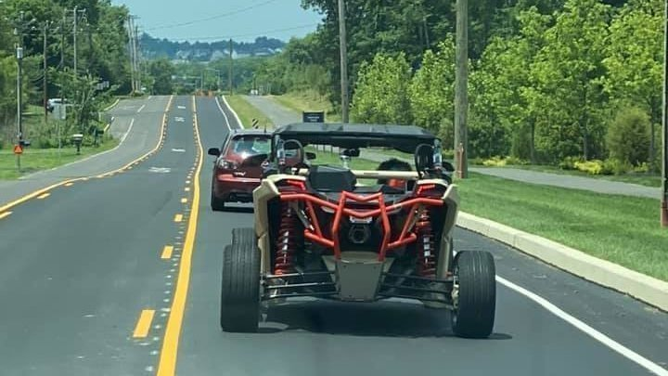
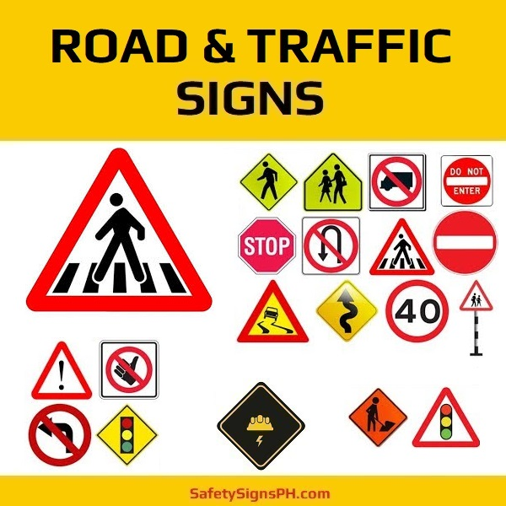
Safe Driving
Importance of safe driving
Being focused and giving your full attention to driving
No texting or talking on your cell phone while behind the wheel. If you are involved in an accident while operating a vehicle on University business and you are conducting a call, texting, or accessing and using internet transmissions, you will be subject to corrective actions up to and including termination. https://www.pts.pitt.edu/mobility/fleet-services/mobile-device-guidelines
Make the safety of yourself and others your top priority.
Driving Safely on Public Roads – OAKLAND CAMPUS
UTVs must be driving at a safe speed given the operating conditions
Excessive speed requires a greater stopping distance and increases risk of tip over on corners
Maintain a safe distance behind other vehicles
Refrain from traveling via roadways at peak traffic hours if possible
Stay alert for traffic and roadside obstacles

Slide 13
Safe Driving
Driving Safely on University Property
When driving on travel path or sidewalk, do not exceed the speed of bicyclists or pedestrians
Do not block sidewalks or travel paths
Use extreme caution when approaching pedestrians and always give them right of way
Utilize curb cuts when navigating from roadways to sidewalks. Jumping curbs can cause damage and compromise vehicle control.
When leaving UTV, the vehicle must be taken out of gear, ignition must be turned off, and parking brake applied. Remove and secure ignition key from unauthorized use.
Avoid areas that are highly congested with pedestrians
If driving in a congested area, use a spotter to assist with crowd control
Driving Safely Off Road
Be alert to ground hazards, look ahead at the terrain
Watch for holes, ruts, and other obstacles
Watch for uneven surfaces, drop offs, and overhead clearance obstructions
Reduce speed according to the terrain and visibility conditions
Avoid slopes if possible. Travel up and down on slopes, not sideways.
Never cross a body of water where the depth is unknown

Slide 14
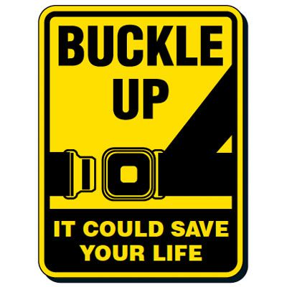
Safe Driving
Defensive Driving
Stop at all blind intersections and then proceed with caution
Yield to pedestrians
When approaching individuals from behind, sound the horn and do not proceed until eye contact has been made
Never drive toward an individual standing in front of a fixed object
Ensure other drivers have seen the UTV prior to progressing
Verify safety prior to all turns. Look over shoulder in direction of travel prior to turn to check for motor vehicles, pedestrians, and bicyclists.
Ensure use of seat belts if equipped.
Passenger Safety
Keep head, legs, and arms within cab
Remain in seats
Do not exceed manufacturer’s load limits (Number of passengers or weight)
Use seat belts if provided
Warn passengers of rough terrain that way cause you to bounce or swerve
Parking
When mounting or dismounting vehicle, it must be placed in the neutral or park position and shut off
Never park within 20 feet of entrances/exits of buildings (except at loading docks or approved parking spots)
Do not block entrances, stairways, fire exits, fire hydrants, disability ramps or main thoroughfares

Slide 15
Maintenance
Follow owner’s manual for maintenance schedule
Records of all recommended maintenance and repair should be kept by the department

Slide 16
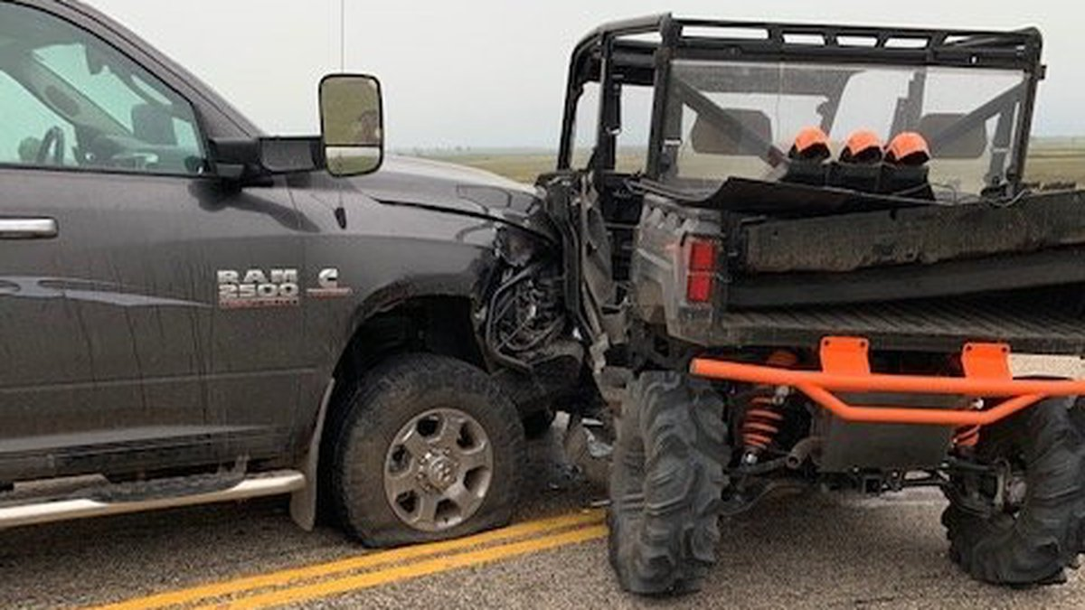
Accidents
Report any accident immediately to:
Your supervisor
Environmental Health & Safety
Complete a Vehicle Accident Report Form (VARF) by following the guidelines https://www.pts.pitt.edu/mobility/fleet-services/reporting-vehicle-accidents
PLEASE WRITE UTILITY VEHICLE ACCIDENT ON TOP OF VARF
Any accident involving a pedestrian or car must be reported to Pitt Police

Slide 17
Questions
Please direct any questions to your supervisor or the Department of Environmental Health & Safety
safety@pitt.edu
412-624-9505

